Slide 1
Axial Force Diagrams and Torsion Diagrams
Dr. Jacob Moore
Associate Professor of Engineering
Penn State Mont Alto

Slide 2
The Graphical Approach
By splitting a body at a specific point and performing an equilibrium analysis, we can find the internal forces and moments at that point.
If we want to look at a second point, we will need a second analysis.
Often however, it will not be obvious where those internal forces or moments will be the highest, and we may want to look at several possible points.
A graphical approach can be used to plot the normal forces, shearing forces, torsional moments, or bending moments along the axis of the body, allowing us to easily pick out the maximum values.

Slide 3
Axial Force Diagrams and Torsion Diagrams
In a column or cable, we can use some simple rules to plot out the internal axial (normal) forces.
In a shaft, we can use some simple rules to plot out the internal torsional moments.
These have separate applications, but the rules are very similar in each case.
V₁
M₁
V₂
T
M₂
N

Slide 4
Axial Force Diagrams
An axial force diagram, plots out the internal normal forces (tension or compression) along the length of a column, cable or other body that is supporting multiple forces along the body.
a
b
D
A
B
C
a
b
A
B
C
A
B

Slide 5
Axial Force Diagrams
a
b
D
A
B
C
a
b
A
B
C
A
B

Slide 6
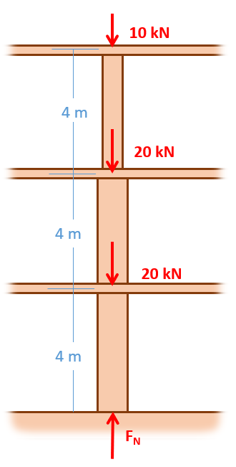
Creating an Axial Force Diagram
Just as with the prior methods, the first step in plotting out the internal axial forces is to determine all the external forces acting on the body.

Slide 7
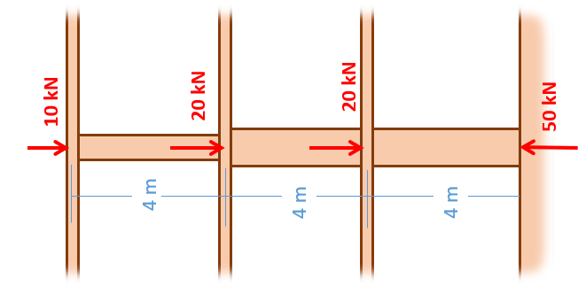
Creating an Axial Force Diagram
Once you determine the external forces, draw the body horizontally (rotate if necessary).
Draw a set of axes lined up below the body. The x-axis represents the location (corresponding with the diagram above) and the y axis represents the internal force at that location (positive numbers represent an internal tension, negative numbers represent an internal compression).
Location (m)
Force (kN)

Slide 8
Creating an Axial Force Diagram
To fill out the diagram, you will start at the left at zero.
As you move to the right, jump upwards by the given amount for forces to the left, and jump downwards by the given amount for forces to the right.
You should always wind up back at zero by the end.
Location (m)
Force (kN)
-10 kN
-30 kN
-50 kN

Slide 9
Torque Diagrams
A torque diagram, plots out the internal torsional moment along the length of a shaft or other body that is supporting torques
a
a

Slide 10
Creating a Torque Diagram
Just as with the prior methods, the first step in plotting out the internal torques in a shaft is to determine all the external moments on the shaft.
A
B
C
5 kNm
15 kNm
10 kNm
30 cm
20 cm

Slide 11
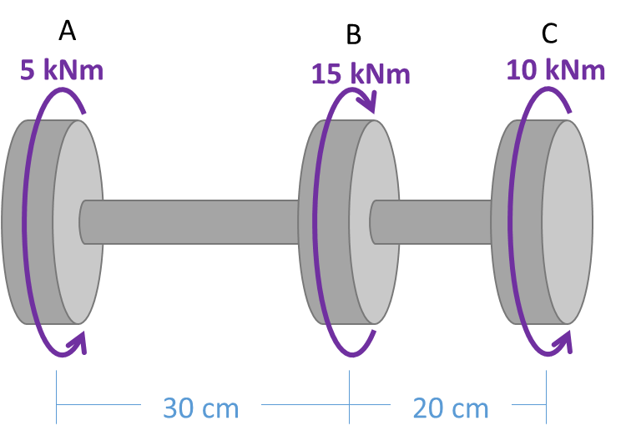
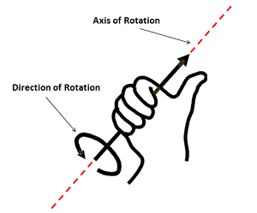
Creating a Torque Diagram
Once you determine the external moments, draw the shaft horizontally (rotate if necessary).
Draw a set of axes lined up below the body. The x-axis represents the location (corresponding with the diagram above) and the y axis represents the internal torque at that location (positive numbers represent moment vectors in the positive x direction, negative numbers represent moment vectors in the negative x direction).
Torque (kNm)
Location (cm)

Slide 12
Creating a Torque Diagram
To fill out the diagram, you will start at the left at zero.
As you move to the right, jump upwards by the given amount for negative moments (moment vector the to left), and jump downwards by the given amount for positive moments (moment vector the to right) .
You should always wind up back at zero by the end.
10 kNm
Torque (kNm)
Location (cm)
-5 kNm

Slide 13
Thanks for Watching
See other engineering mechanics videos and access the full tool at…

Slide 14
Axial Force Diagram Worked Example
A wooden beam is subjected to the forces shown below (forces applied at base of vector). Draw the axial force diagram for the beam.
60 lbs
90 lbs
60 lbs
90 lbs
12 in
12 in
24 in
A
B
C
D

Slide 15
Axial Force Diagram Worked Example
A cable is anchored to the ceiling and subjected to the forces shown below (assume are forces applied at base of the vector). Draw the axial force diagram for the cable.
60º
60º
3 m
4 kN
4 kN
2 m
2 kN
2 m
3 kN

Slide 16
Torsion Diagram Worked Example
A steel shaft is subjected to the torques shown below. Draw the torque diagram for this shaft.
A
B
C
5 kNm
15 kNm
10 kNm
30 cm
20 cm

Slide 17
Torsion Diagram Worked Example
A steel shaft is subjected to the torques shown below. Draw the torque diagram for this shaft.
A
B
C
D
E
60 ft-lbs
15 ft-lbs
35 ft-lbs
50 ft-lbs
40 ft-lbs
2 ft
2 ft
2 ft
2 ft

